Slide 1
Inheritance
Lecturer: Ngo Huy Bien
Software Engineering Department
Faculty of Information Technology
VNUHCM - University of Science
Ho Chi Minh City, Vietnam
nhbien@fit.hcmus.edu.vn

Slide 2

Objectives
To present what is inheritance.
To create classes with inheritance.
To present why use inheritance.
To present what is casting.
To present why use casting.
To present what is an interface.
To implement interfaces.
To present why use interfaces.
To create abstract classes, methods and properties.
To present why use abstract methods.

Slide 3

References
Jim Keogh and Mario Giannini (2005). OOP Demystified: A Self-Teaching Guide.
Tom Archer and Andrew Whitechapel (2002). Inside CSharp.

Slide 4
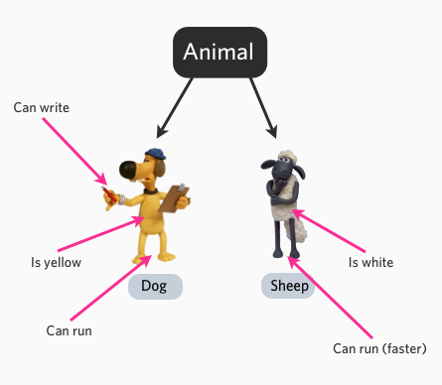
Code Duplication
Inheritance, the ability to say that these objects are just like that other set of objects EXCEPT for these changes.

Slide 5

Inheritance [1, 2]
Base (super) class
What is inheritance? – Property and Method Transfer
Student
Person
Subclassing
Derived (sub) class
Constructors are not transferred
Student IS A Person

Slide 6
Reuse (Code Sharing)

Slide 7

Simple Inheritance

Slide 8
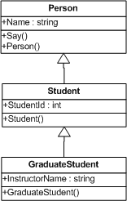
Level Inheritance

Slide 9

Base Class’s Constructor
The base class’s constructor with no arguments will be called before any statements in the derived class’s constructor body is executed.

Slide 10
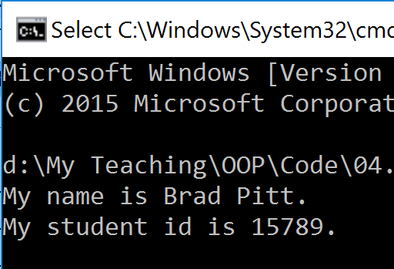
Calling Base Class’ Constructor

Slide 11
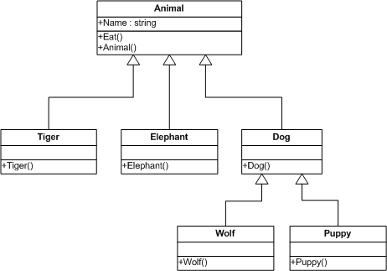
When To Use Inheritance?
Subtyping
“IS A” relationship
Sub Types
Subtyping
“IS A” relationship
Sub Types

Slide 12

Why Use Inheritance?

Slide 13
Root Class
Object
ValueType
Laptop
Person
Toshiba
Acer
Ahmed’s Toshiba
Peter’s Toshiba

Slide 14


Sealed Class

Slide 15
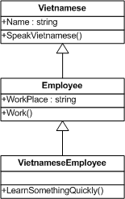
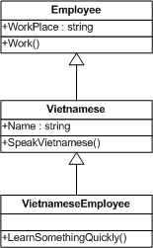
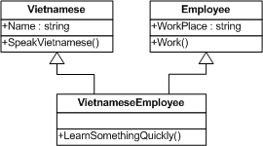
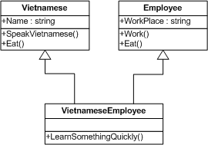
Multiple Inheritance with Class

Slide 16
Casting
Up casting – Converting a reference of a derived class to its base class.
Man
Eat
Work
Person
Eat
Down casting – Converting a reference of a base class to its derived class.
Person
Eat
???
Man
Eat
Work

Slide 17
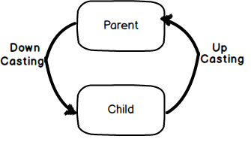
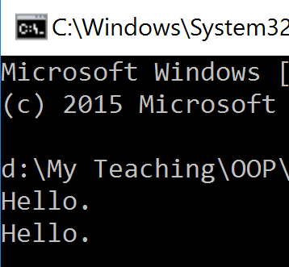
Why Use Casting?

Slide 18
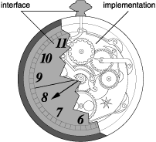
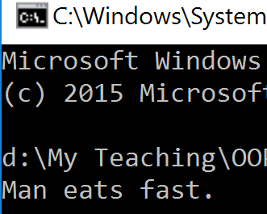
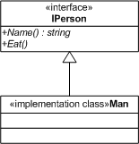
Interface
Interface is a first-class concept that declares methods and properties declarations only.
Once an interface is defined and a class is defined as implementing that interface, that class MUST IMPLEMENT all methods defined in the interface
CAN

Slide 19

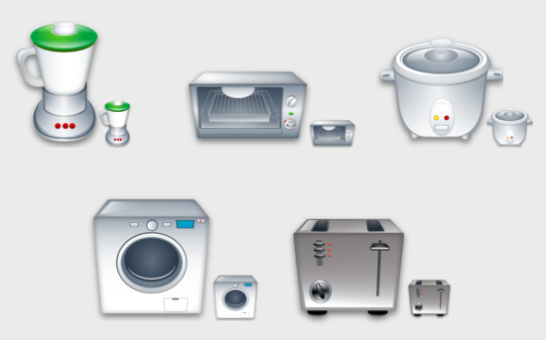
Why Interface?
IPlugable
IPlugable implementations

Slide 20
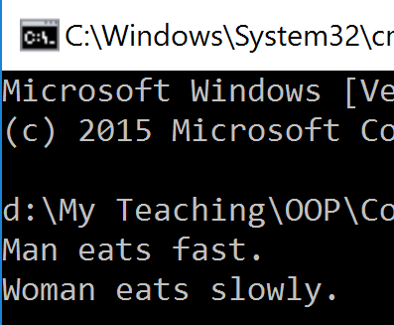
Example
Interface is a contract between two disparate pieces of code.

Slide 21
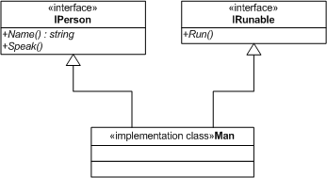

Multiple Inheritance With Interface

Slide 22
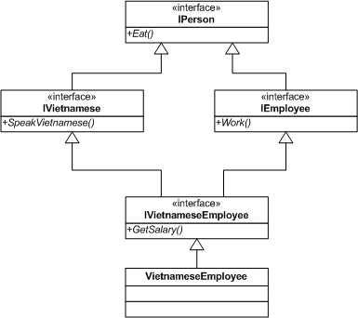
Combining Interfaces

Slide 23
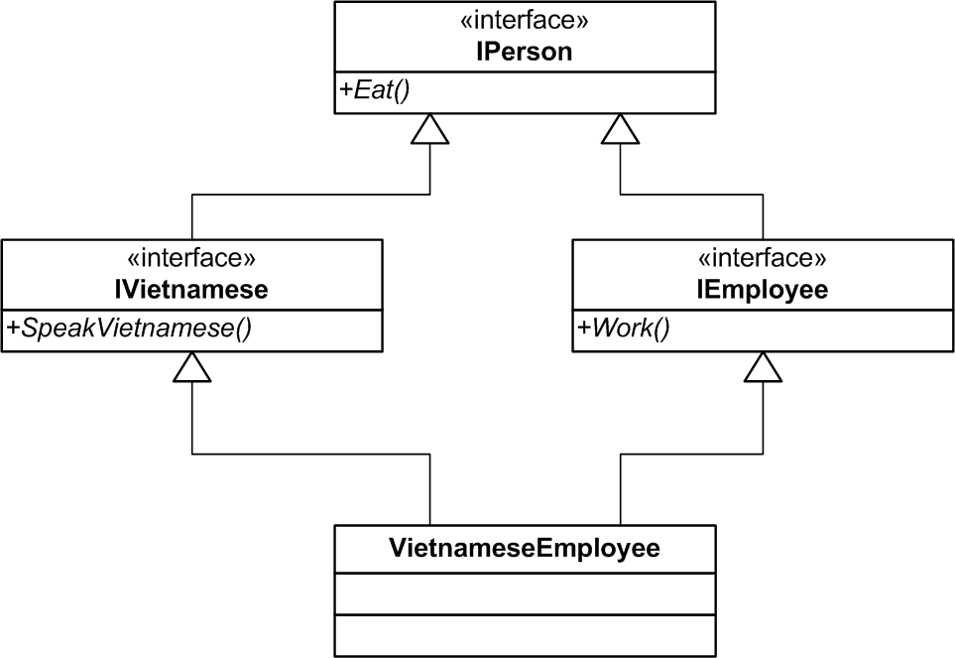
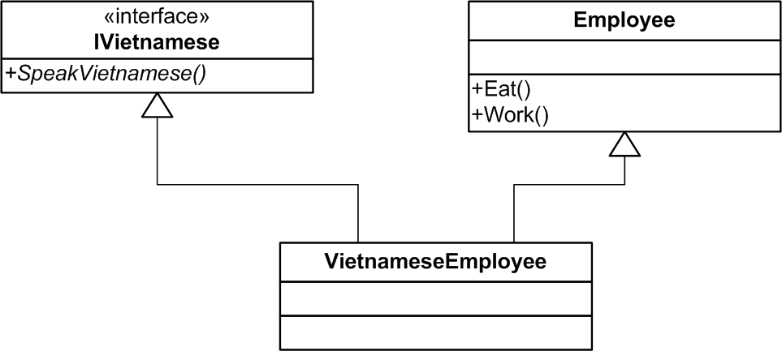
Interface vs. Base Class
Interfaces are more flexible than base classes because you can define a single implementation that can implement multiple interfaces.
Interfaces are useful when you cannot use class inheritance. For example, structures cannot inherit from classes, but they can implement interfaces.
Interfaces are more simple for clients to use.

Slide 24


Slide 25
Abstract Class
An abstract class is a class that won’t be instantiated but serves as a class definition for derivation.
Abstract Class
Concrete Class
Concrete Class
Creation Is Forbidden

Slide 26

Abstract Method
An abstract method is a method defined in a super class that must be redefined in a subclass that inherits the super class.

Slide 27

Abstract Property
Members that are defined as abstract within an abstract class must be implemented by any derived classes.

Slide 28

Abstract Class vs. Interface
Default Implementation
Access Modfiers
Fields and Constants
Adding Functionality
(Versioning, Changes)
Speed
Multiple Inheritance
Core vs. Peripheral
IS A vs. CAN
Homogeneity
(Common behavior vs. method signature)

Slide 29
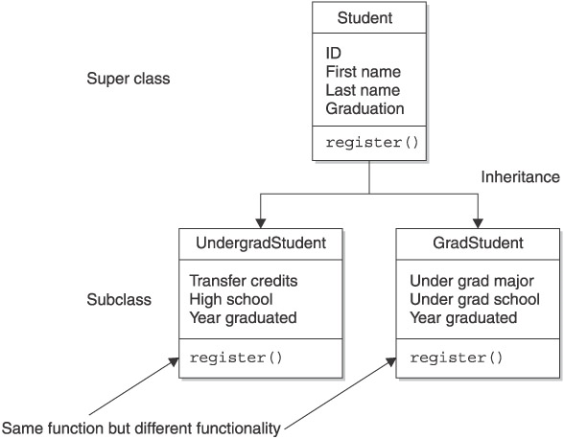
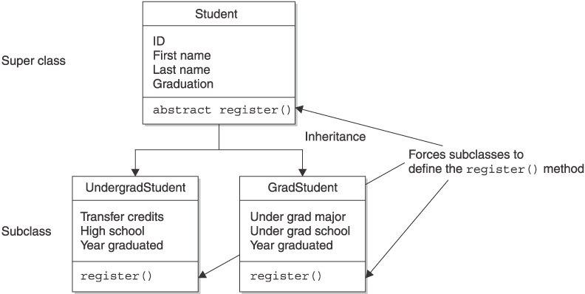
Why Use Abstract Methods?
Using abstract methods is a way a programmer of a super class forces a programmer of a subclass to define a behavior.
An abstract method should be used when there isn’t any way to define a good default method in the super class.

Slide 31
“Kinds” Of Inheritance
Specialization – The derived class adds more functionality and/or overrides some of the existing functionality.
Extension – A particular form of specialization in which more functionality is added but none of the existing functionality is overridden.
Realization of a Specification – An "abstract class" or "interface" (both of which contain unimplemented methods) is used as the base to realize a concept merely "specified" in that base.
Combination is to "inherit from", or "extend", a single base class, and simultaneously "implement" one or more "interfaces".

Slide 32

Mixin Inheritance
MixIn programming is a style of software development where units of functionality are created in a class and then mixed in with other classes.

Slide 33
C++ Private Inheritance
http://c2.com/cgi/wiki?PrivateInheritance
Private inheritance results in all public functions of a class being inherited as private functions.
Private inheritance models the "is implemented in terms of a" relationship, rather than the is-a relationship that is modeled by public inheritance.
Why private inheritance? – To hide some functions of the base class.
http://www.dofactory.com/net/adapter-design-pattern

Slide 34

Thank You for Your Time

